Slide 1


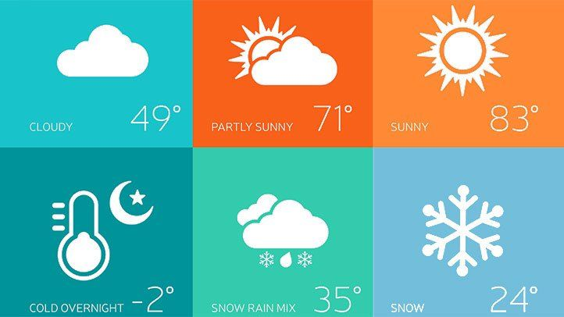

Univariate Time Series Analysis For Weather Prediction Using Prophet Library
Team Members:
T. Manvitha
T. Lakshmi Prasanna
V. Likitha
N. Kirthana
V. Nithin

Slide 2
Time series analysis is the use of statistical methods to analyze time series data and extract meaningful statistics and characteristics about the data. Time series analysis helps identify trends, cycles, and seasonal variances to aid in the forecasting of a future event. Factors relevant to time series analysis include stationarity, seasonality and autocorrelation. Time series forecasting uses information regarding historical values and associated patterns to predict future activity.
There are many models present for the predictive analysis of time series like Machine learning ARIMA (Auto-Regressive Integrated Moving Average model), Auto-Regressive model, Exponential Smoothing, LSTM (Long Short Term Memory), etc. These models require the data to be fed and with certain tweaking and fine-tuning they help us to make predictions. But, Facebook Prophet library is a third party library that could perform all the fine-tuning part within and we just need to feed the model .

